Slide 1
Reunions
By Andrew Sneed

Slide 2
Notes before you start
Thanks for a great semester!
You can reach any part of the app, from any other part of the app.
Navigation is achieved by click on the light green boxes surrounding the navigation options
The boxes look like this:
Note: Some of the Cthulhu themed stuff is still in here. I dind’t have time to switch them over to the new theme

Slide 3
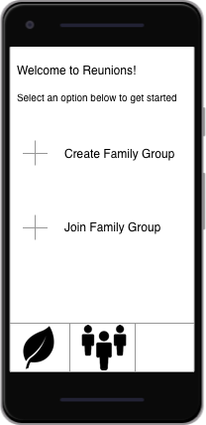
Startpage
Displays after user logs in
Offers the options to Create/Join Family groups
Leaf – Links to user profile
People – Opens list of families the user is a member of

Slide 4
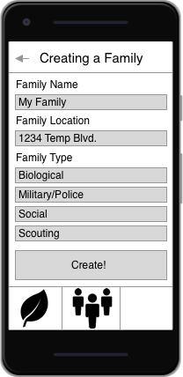
Create A Family
Enter a name to replace the template
Enter a location, hooks into Gmaps API to confirm
Pick family type, Biological by Default
Selecting “Create!” sends user to the “View Families” page

Slide 5
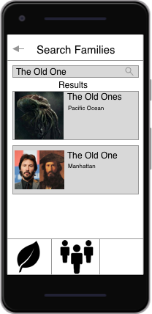
Join A family Group
Search by family name, but there is an option to make family private(unsearchable)
Results only reveal designated group photo, Family Name, and City

Slide 6
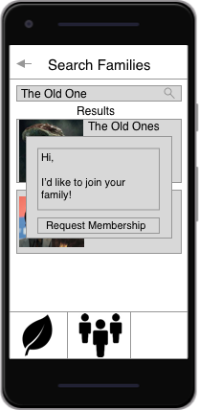
Request Membership
Sends a text message to the head of the family group, 1-255 characters long. The default message is shown.
Selecting “Request Membership” sends user to the “View Families” page

Slide 7
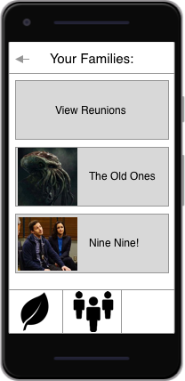
View Families
Top option always offers to display a list of all the reunions
Just shows a list containing group photo and Family Name

Slide 8
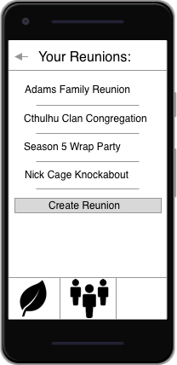
Reunion List
Easy to select a reunion
Organized alphabetically
Option to create a reunion

Slide 9
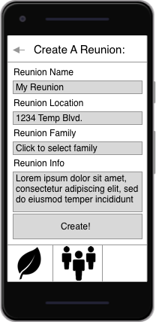
Create Reunion
Enter a name to replace the template
Enter a location, hooks into Gmaps API to confirm
Select the family that will gather at the reunion
1-255 character info blurb
Selecting “Create!” sends user to the newly-created Reunion page

Slide 10
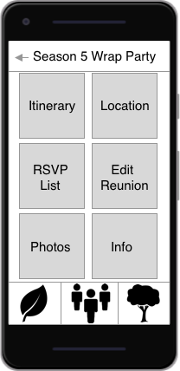
View Reunion
Shows tiles that link to different parts of the reunion
Selecting family tree will show the family tree
”Edit Reunion” sends the user to a page of the same name, if they are allowed to edit. That page contains options to edit all the different parts of the reunion
Notes:
Didn’t have time to do Edit Reunion, I had to take my Programming Languages final.

Slide 11
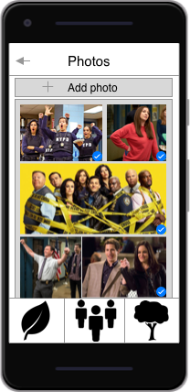
View Photos
Displays photos scrapbook/collage style, checkmarks are photo’s people like.
Option to add photo opens recent photos taken.
Can select photos to view/write comments

Slide 12
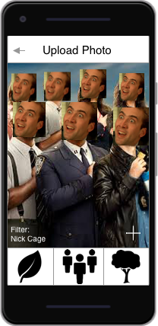
Add Photo
Upload photo lets the user select a photo, as well as make edits beforehand
The proprietary Nick Cage filter uses deep learning and neural networks to substitute the face everyone in a photo with that of Nicholas Cage
Selecting the ”+” uploads the photo to the current reunion photo album

Slide 13
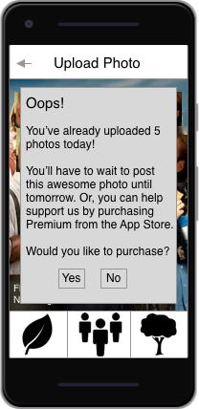
Upgrade to Premium
Unfortunately we have to feed our families, so we’re charging money for certain functionality. A message similar to this will appear whenever the user tries to do something requiring premium
It’s important to note: we handle this through the App Store/Google Play Store. Yes, they’ll get a cut of the revenue, but we’ll save more in the long run from not having to secure customer credit card information, manage receipts, etc.

Slide 14
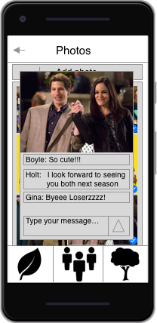
View/Comment on photos
Pick a photo in particular
Like or comment
View comments of others

Slide 15
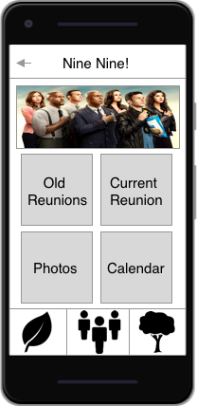
Family Page
First time the Family Tree option becomes available, click to view
Displays family banner(separate from group photo displayed in search results)
Contains links to:
Old reunions
Current reunion (next reunion by default, unless one is currently going)
Photo collections
Calendar

Slide 16
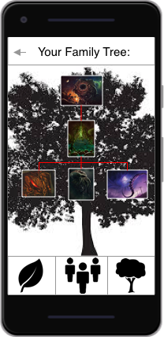
Family Tree
Live, accurate genealogy chart of reunion participants
Works if family is of types military, social, or Scouts. Uses separate algorithms to generate each tree
Automatically generated each time a user joins the reunion
Tap on the picture of a family member to view their leaf

Slide 17
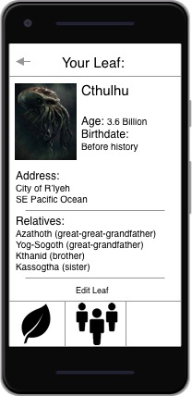
Leaf Page
The user’s profile
Contains the relevant relationship information
When joining a reunion, this data is automatically added to the Family Tree

Slide 18
Credits
UI images made in Sketch
Google and H.P. Lovecraft wiki for images
Chacho’s

